Slide 1
Shape of Training – changes to Core Training pathway and implementation plans in Severn
For College Tutors and Doctors in Training
January 2023

Slide 2
Shape of training / Progress+
Structural change
  Reduction in the overall indicative length of training from eight to seven years
  Change to two training levels: Core Paediatrics (Year 1-4) and Specialty Paediatrics (year 5-7)
Changes with a view to improving flexibility:
  Embedding capability rather than time-based training
  Removal of the requirement to do six-month blocks (eg neonates, community child health)
  Mapping of similarities between sub-specialties so trainees can change pathway and count capabilities already achieved
  Promotion of OOP (out of programme) opportunities

Slide 3
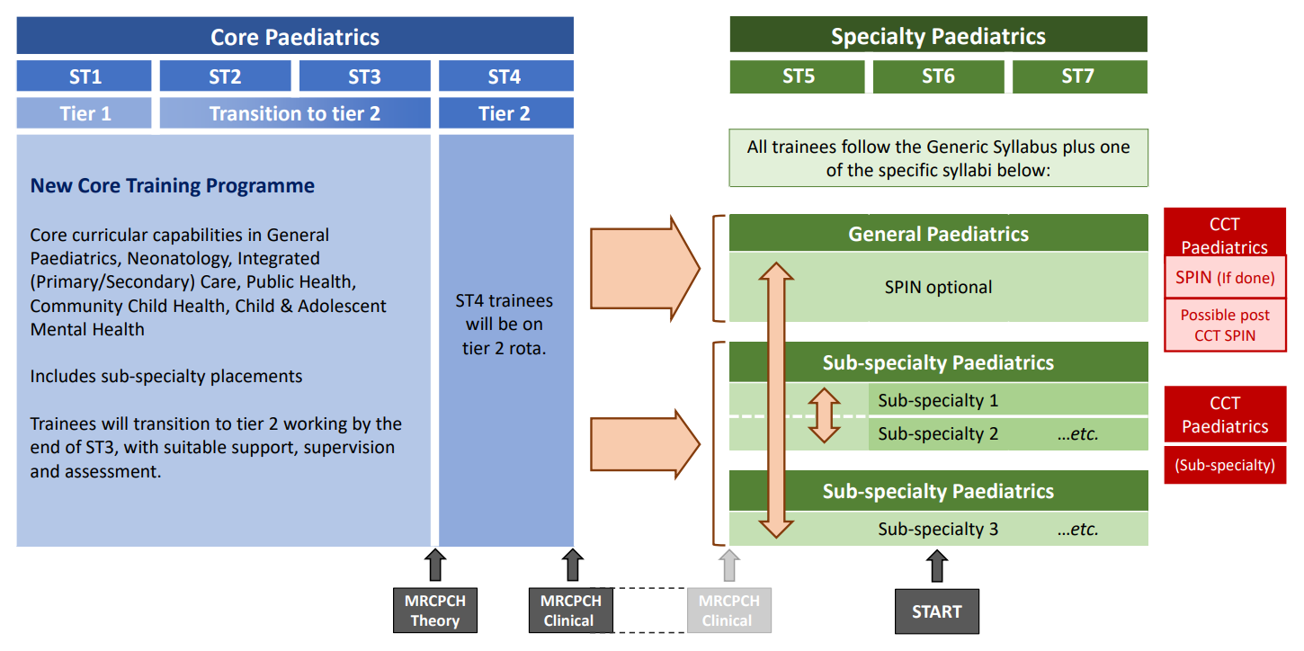
Training pathway

Slide 4
Current training pathway ST1-4 in Severn
6 months DGH tier 1 (1st ST1 post)
24 months specialties to include 12 months of tertiary NICU and 12 months paediatric specialties at tier 1 (2nd ST1 post, ST2 and 1st ST3 post)
6 months DGH tier 1 “Step Up”, with supported opportunities to act as middle grade (2nd ST3 post)
Then….
Transition to ST4 in DGH as middle grade/tier 2 working

Slide 5
Progress+ - challenges with implementation in Severn
Key challenge – moving tier 2 working to ST3
Need to ensure training requirements and capabilities for tier 2 working are met – implications for enhanced supervision of more junior doctors on tier 2 rotas (ST3)
Maintaining consistent placement numbers across a training year
Ensuring programme aligns with Progress+
Moving from an 8 year to a 7 year programme – where to lose the year of training

Slide 6
Key principles underpinning Severn plan
6 months to be lost from tier 1 rotas and 6 months from tier 2 rotas – aims to maintain tier 2 rotas and encourage workforce planning to maintain service delivery at tier 1
Tertiary neonatal placements changed from minimum of 12 months to minimum of 6 months
Incorporation of CCH, CAMHS, public health, primary care exposure into tier 1 departmental rotas (already reflected in regional training days)
Ensuring acute paediatric experience/training within specialty placements in BCH
Aligning with Progress+ curriculum and implementation of a 2 level training programme (ST1-4 and ST5-7) – current ST3 advised to start aligning evidence to the current level 2 curriculum; F2F planning meetings with ST4 DiT completed
Repurposing ST5 posts into tier 2 DGH ST3 posts
Maintaining DiT envelope – increasing recruitment at ST1 (2 posts)

Slide 7
Current programme / post planning
Usually have approx 15 ST DiT per year (more with LTFT working, but these trainees usually slot share so same number of posts)
In Sept
  15 ST1 in DGHs
  3 - 4 ST3 at St Michs
  3 - 4 ST3 at Southmead
  7 – 9 ST3 at BCH
In March
  15 ST3 in DGHs
  15 ST1s in Bristol – similar distribution to ST3s in Sept

Slide 8
Proposed new training pathway for ST1-4
ST1 – 1 year DGH
ST2 – 1 year Bristol – 6 months NICU, 6 months specialties
ST3 - 6 months on tier 2 in a DGH and 6 months in a specialty in Bristol, in either order
  Ensures consistent training placement numbers across the ST3 training year.
ST4 – 1 year DGH tier 2

Slide 9
Numbers
DGH tier 1 rotas
  will be stable, but with more junior DiT (ST1) from March – Sept
DGH tier 2 rotas –
  ST3 DiT will be on the tier 2 rota along with ST4 DiT and in transition phase ST4+ (previously known as ST5).
  They will need a higher level of support than those stepping up in ST4 – potential to set up a ST4+ mentoring system for Sept 2023 – Sept 2024
Bristol tier 1 rotas
  All hospitals will lose a number of tier 1 trainees (NICUs 2-3, BCH 4-6)
Bristol tier 2 rotas
  Numbers will be largely unchanged as ST4/5 currently placed in DGHs for most part
  Trainees will have one year less experience, likely to need more support with decision making etc

Slide 10
Modelling progression through ST1-3, and implications
 | Sept 23 | March 24 | Sept 24 | March 25 | Sept 25 | March 26
ST1 in Sept 23 ST2 in Sept 23 ST3 in Sept 23 | 15 ST1 - DGH | 15 ST1 DGH
 | 15 ST2 Bristol | 15 ST2 Bristol | 15 ST2 Bristol | 15 ST2 Bristol
 | 8 ST3 DGH tier 2 7 ST3 Bristol tier 1 | 8 ST3 Bristol tier 1 7 ST3 DGH tier 2 | 8 ST3 DGH tier 2 7 ST3 Bristol tier 1 | 8 ST3 Bristol tier 1 7 ST3 DGH tier 2 | 7 ST3 DGH tier 2 8 ST3 Bristol tier 1 | 7 ST3 Bristol tier 1 8 ST3 DGH tier 2
Key change | 8 ST3s to tier 2 rota DGH 7 less ST3s in Bristol | 7 ST3s to tier 2 rota DGH (gap created by ST4s moving to OOP or HST) 8 less ST3s in Bristol
DGHs tier 1 | 15 Full | 15 Full | 15 Full | 15 Full | 15 Full | 15 Full
DGHs tier 2 | 7/8 x ST3 | 7/8 x ST3 | 7/8 x ST3 | 7/8 x ST3 | 7/8 x ST3 | 7/8 x ST3
Bristol tier 1 | Approx 2 gaps per NICU Approx 4 gaps BCH | Approx 2 gaps per NICU Approx 4 gaps BCH | Approx 2 gaps per NICU Approx 4 gaps BCH | Approx 2 gaps per NICU Approx 4 gaps BCH | Approx 2 gaps per NICU Approx 4 gaps BCH | Approx 2 gaps per NICU Approx 4 gaps BCH
Bristol tier 2 | Affected by loss of ST5s only | Affected by loss of ST5s only | Affected by loss of ST5s only | Affected by loss of ST5s only | Affected by loss of ST5s only | Affected by loss of ST5s only

Slide 11
Benefits
Educational
Aligns with Progress+
Will require planning for enhanced support/supervision for ST3 tier 2 working – this will benefit DiT
Will allow longitudinal educational supervision
Logistics
Levels out the bump of having all ST3s in Bristol for half a year and then none
Mitigates for the loss of ST5s in DGHs – repurposing “old ST5” posts into ST3 tier 2 posts
Provide a predictable number of ‘gaps’ on the tier 1 rotas in Bristol to inform workforce planning

Slide 12
Risks
ST3 DiT stepping up 6 – 12 months earlier than have done previously – need to ensure training and capabilities with enhanced support on DGH OOH rotas
Rota gaps for the Bristol centres (but this will happen with any model we use involving DiT stepping up earlier than at present). Numbers are now predictable and can be included in workforce planning

Slide 13
Advantages of stepping up in Sept of ST3
Consolidate learning
Small gap away from general paeds and neonates – aim to return to same ST1 DGH in ST3 year to enable step up
Return to Bristol to do some specialty experience with focus on wider curriculum development in second 6 months of ST3 (QI, research etc)

Slide 14
Advantages of stepping up Mar ST3 year
Do all Bristol work in a block
Move to DGH at end of ST3 and potential to stay for ST4
Will enable improved planning around relocation etc

Slide 15
What are we doing?

Slide 16
School plans
Continue CT meetings - DGH clinical tutors to consider what is required to support a ST3 tier 2 DiT; Tertiary Bristol CT to workforce plan for known reduction in tier 1 DiT
Individual meetings with ST2s to discuss which half of the year they will be stepping up in a DGH – CTs to support identification of capable ST2 DiT and complete ECAT assessments https://www.rcpch.ac.uk/resources/assessment-guide#entrustment-with-care-assessment-tool-ecat---pilot
Complete post preference process and allocate DGH vs Bristol
Co-ordinate ST3 and ST4+ placements
Continue to focus on recruitment plans

Slide 17
What do we need from you?

Slide 18
DGH College Tutors
Workforce planning to maintain tier 1 rotas and enable SPA time for DiT and release for educational opportunities
Incorporate community, mental health, public health and primary care training into ST1 placements
Consider and plan for what is required to support a ST3 tier 2 DiT
Potential for a ST4+ mentoring scheme and support of OOH rotas from September 2023 to support ST3 step up onto tier 2 rotas

Slide 19
Bristol College Tutors (BCH and Tertiary NICU)
Workforce plan to maintain tier 1 rotas
Ensure acute paediatric experience/training within specialty placements at BCH
Ensure leadership experience for ST2 DiT
Help to identify which current ST2 DiT would be well placed to step up to tier 2 working in September 2023– complete ECAT assessments to inform process
Support ST3 DiT placed in Bristol from Sep 2023 to build specialty experience and ensure clinical and non-clinical leadership opportunities – particularly to support sub-specialty application

Slide 20
Doctors in Training
Current ST1 DiT:
  Transition onto the new programme at ST2 (Sep 2023) and move over onto Progress+ curriculum
Current ST2 DiT:
  To follow the new Severn training programme from ST3 (Sep 2023)
  Sign up to a meeting with TPD / HoS to discuss previous experience, individual progress and when you would prefer to move to tier 2 (Sept or March slot)
  Discuss your progress with your ES regarding capability for tier 2 working and complete ECAT assessment
  Complete your placement preference form promptly when it comes out
Current ST3
  Start aligning evidence to Progress+ / current level 2 curriculum. Will move to Core ST4 training Sep 2023
Current ST4:
  F2F planning meetings with ST4 DiT completed – to complete post preference forms
Current ST5
  Move to Specialty training from Sep 2023
Current ST6-8
  Remain in General Paediatric/Specialty training

